Slide 1

Definition: It is the power that moderates the concupiscible appetites, (the passion of the sense pleasure.)

Slide 2
Characteristics.
-It governs man’s natural appetite for pleasures of the senses in accordance with the right reason.
-It ensures the will’s master over the instincts and keeps desires within limits of what is reasonable, i.e. it finds the just mean in any pleasurable good.
-It denotes intelligent self control.

Slide 3
-The functions of the body cause a certain amount of pleasure.
-The virtue of temperance consists in submitting these pleasures to the control of reason, a task which requires effort.
-The functions of the body fulfill two ends: eating and drinking preserve the health of the individual, and sex propagates the species.

Slide 4
Parts of Temperance
There are four parts of temperance
1. Abstinence
2. Sobriety
3. Chastity
4. Modesty

Slide 5
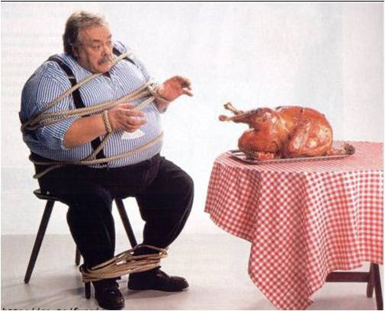
Moderation in food intake

Slide 6
1. Abstinence
- Temperance in eating is called abstinence, and it does not mean eating nothing, but avoiding the various forms of gluttony.
- Abstinence means not to eat to the full so as to be genuinely hungry when the time for eating comes.
- Gluttony leads to obesity and bad health.

Slide 7

Soberness???### !!!!!!!!!

Slide 8
2. Sobriety
Sobriety does not mean to abstain from drink but to drink with reason.
- A glass of wine or beer, taken during meals enhances digestion and makes merry, but outside meals and in excess, leads to drunkenness.
- Sobriety distinguishes between what is reasonable and what is immoderate.

Slide 9
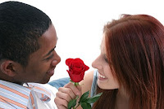
Chastity

Slide 10
3. Chastity
Regulates the use of reproductive powers according to reason, i.e. it puts order into the sexual appetite.
- Reason sees that these powers exist for the good of the species, not for that of the individual, who should live chastity within and outside marriage.

Slide 11
- Reason also dictates that these powers be used exclusively within marriage, and for the purpose of marriage that is fully open to life.
- Marriage is not a remedy for impurity, as the person who has not been faithful to God before marriage, will hardly be faithful to his or her spouse.

Slide 12

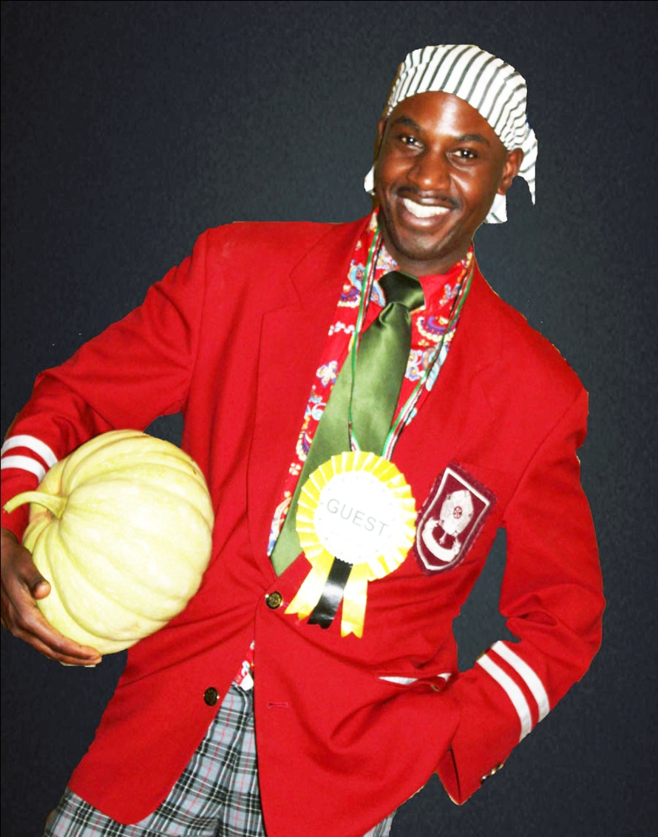
Modesty

Slide 13
4. Modesty
It regulates the pleasure of dressing well.
- To be elegant means to dress according to one’s measure (or standing) and for the occasion.
- It also means to be able to match the color and form of dress in order to pass unnoticed.
- Elegance is a social virtue which makes people comfortable in the presence of an elegantly dressed person.

Slide 14
Vices against Temperance
Read the ‘Art of Total Living,’ from page 78.
a) Unnatural deprivation:- fleeing from natural pleasures as if they were evil.
b) Gluttony:- it is usually defined as a disordered inclination to eat or the excessive indulgence in food and drink.
c) Drunkenness:- is the loss of reasoning powers due to drinking excessive alcohol.
Addictive drugs have the same effect.
d) Lust:- is disordered desire for sexual pleasure sought for itself.
e) Shabbiness:- completely neglecting external appearance.
f) Frivolity:- dressing extravagantly for no reason.
These two attract attention, elegance does not.

